Slide 1

WALMART SALES ANALYSIS AND INSIGHTS
A SQL-Based Approach
By Meghna Ghosh
MBA Integrated
Data Analyst Intern

Slide 2


Project Overview
Objective
To analyze Walmart's sales data to derive actionable insights.
Tools Used
SQL for data querying and analysis
Scope
Analysis based on 15 key business questions.

Slide 3
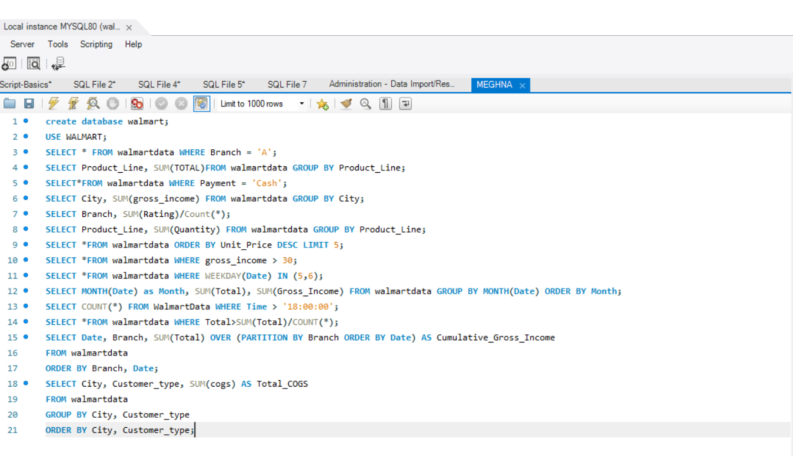
Branch-Specific Sales Analysis
Query: SELECT * FROM walmartdata WHERE branch = ‘A’;
Insight: This helps in understanding the sales performance of specific branches.

Slide 4
Total Sales by Product Line
Query: SELECT Product_Line, SUM(total) AS total_sales FROM walmartdata GROUP BY Product_Line;
Insight: Identifies which product lines are the most profitable.

Slide 5
Sales Transactions with 'Cash' Payment
Query: SELECT * FROM walmartdata WHERE payment = 'Cash’;
Insight: Understanding cash transactions can help in cash flow management.

Slide 6
Total Gross Income by City
Query: SELECT city, SUM(gross_income) AS total_gross_income FROM walmartdata GROUP BY City;
Insight: Helps in evaluating city-level profitability.

Slide 7
Customer Ratings
Query: SELECT branch, SUM(rating) /Count(*);
Insight: Measures customer satisfaction at the branch level.

Slide 8
Product Line Quantity Sold
Query: SELECT product_line, SUM(quantity) AS total_quantity FROM walmartdata GROUP BY product_line;
Insight: Indicates demand for different product lines.

Slide 9
Top 5 Products by Unit Price
Query: SELECT * FROM sales ORDER BY unit_price DESC LIMIT 5;
Insight: Focus on high-value items for maximizing revenue.

Slide 10
High Gross Income Transactions
Query: SELECT * FROM walmartdata WHERE gross_income > 30;
Insight: Targeting high-income transactions for optimization.

Slide 11
Weekend Sales Transactions
Query: SELECT * FROM walmartdata WHERE DAYOFWEEK(date) IN (1, 7);
Insight: Understanding weekend sales patterns.

Slide 12
Monthly Sales and Gross Income
Query: SELECT MONTH(date) AS month, SUM(total) AS total_sales, SUM(gross_income) AS total_gross_income FROM walmartdata GROUP BY month;
Insight: Seasonal trends in sales and profitability.

Slide 13
Evening Sales Transactions
Query: SELECT * FROM sales WHERE HOUR(time) > 18:00:00;
Insight: Understanding evening shopping behavior.

Slide 14
Sales Transactions Above Average Total
Query: SELECT * FROM walmartdata WHERE total > (SELECT AVG(total) FROM walmartdata);
Insight: Focus on high-value transactions.

Slide 15
Cumulative Gross Income
Query: SELECT branch, date, SUM(gross_income) OVER (PARTITION BY branch ORDER BY date) AS cumulative_gross_income FROM walmartdata;
Insight: Tracking financial growth over time.

Slide 16
COGS by Customer Type and City
Query: SELECT city, customer_type, SUM(cogs) AS total_cogs FROM walmartdata GROUP BY city, customer_type;
Insight: Understanding cost structure across customer types and cities.

Slide 17


Conclusion
Summary of insights.
Highlighted branch-level sales performance.
Identified top product lines and high-value transactions.
Uncovered key trends in customer behavior, payment methods, and city-level profitability.
Recommendations
Focus on top-performing product lines to maximize profitability.
Leverage insights on customer behavior to optimize marketing strategies.
Use city-level data to allocate resources effectively and boost regional sales.

Slide 18

THANK YOU!

